Slide 1
Thirsty Plant
A Smart Plant For the Smart City.
IOT GRP-22
Ayan Kumar Sinha
Bodhisatwa Das
Souvik Mitra
Subham Sarangi
Under Supervision OF
Mr. Joy Dutta, Researcher(CSE), JU.

Slide 2
INDEX
Introduction
Motivation
Instrument/ Sensor/ Modules Used
Diagram Explanation
Result & Analysis
Conclusion
References

Slide 3
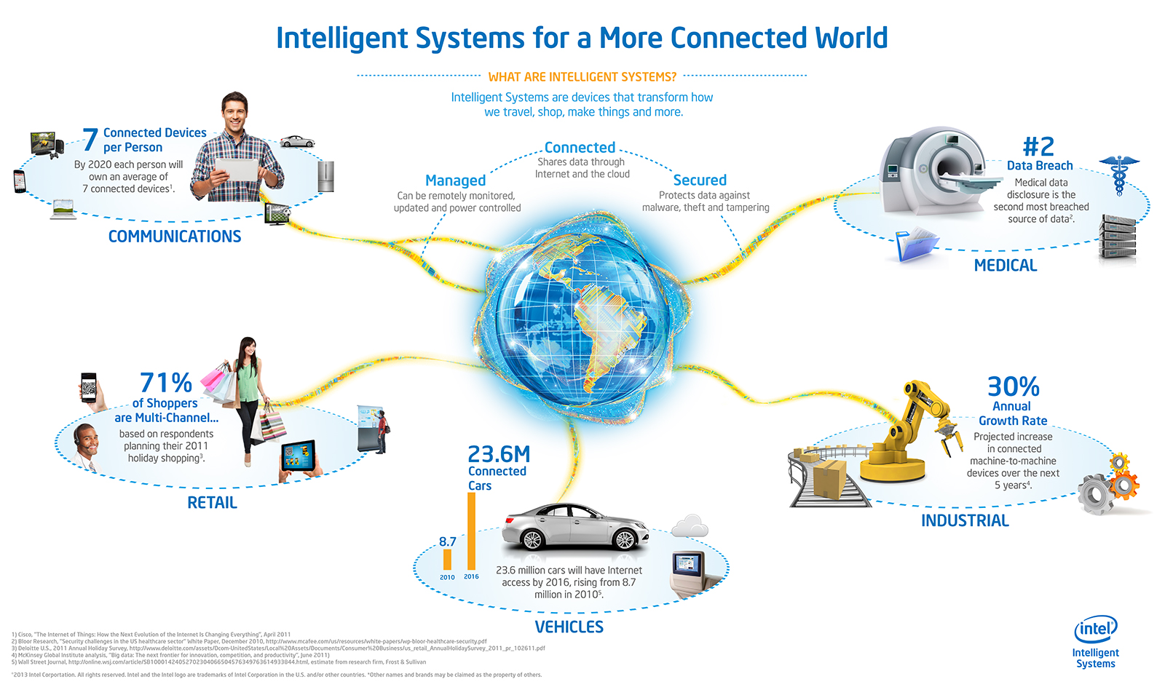
Introduction

Slide 4
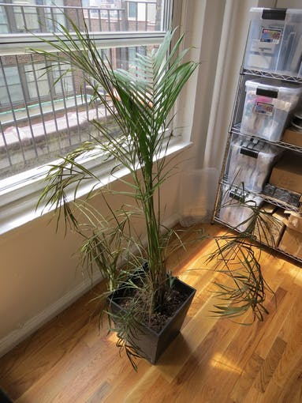
Motivation
Even though we made everything smart and connected to the cloud, We seemed to forget to make smart of our own .
Look at this dying plant. Counting its days.
Does it deserve to die like this?
Why not we make this plant a smart plant?

Slide 5
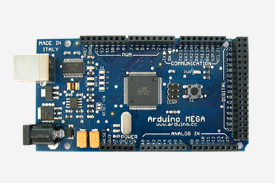
Instrument/ Sensors/ Modules Used
Arduino Mega 2560

Slide 6
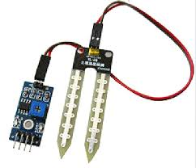
Instrument/ Sensors/ Modules Used
Soil Moisture Sensor

Slide 7
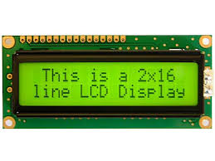
Instrument/ Sensors/ Modules Used
LCD Display Unit

Slide 8
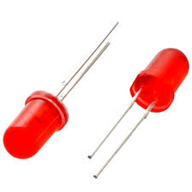
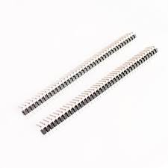
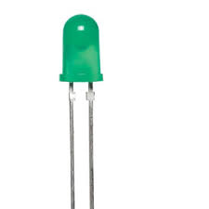
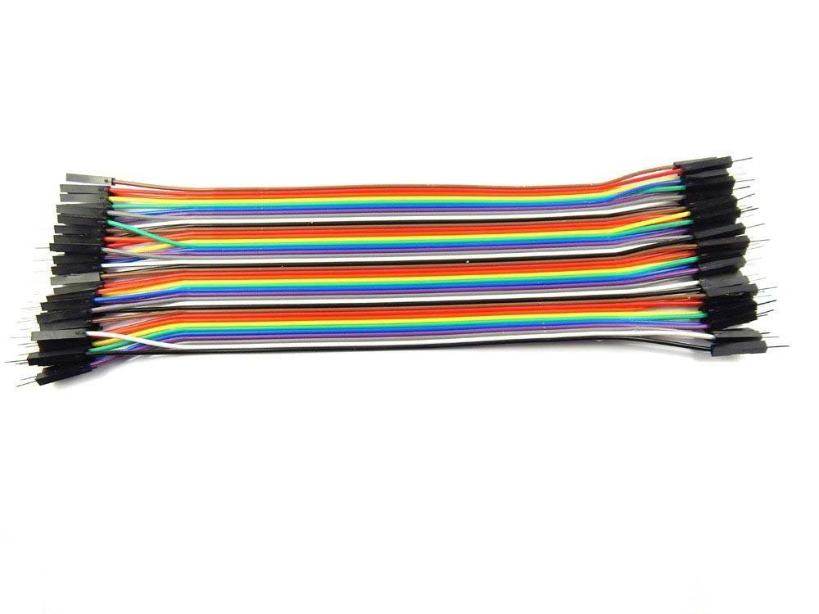
Instrument/ Sensors/ Modules Used
Jumper and LED’s And Some PINs

Slide 9
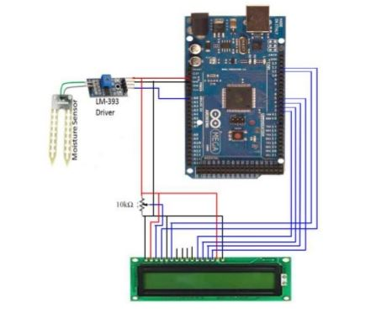
Diagram Explanation

Slide 10
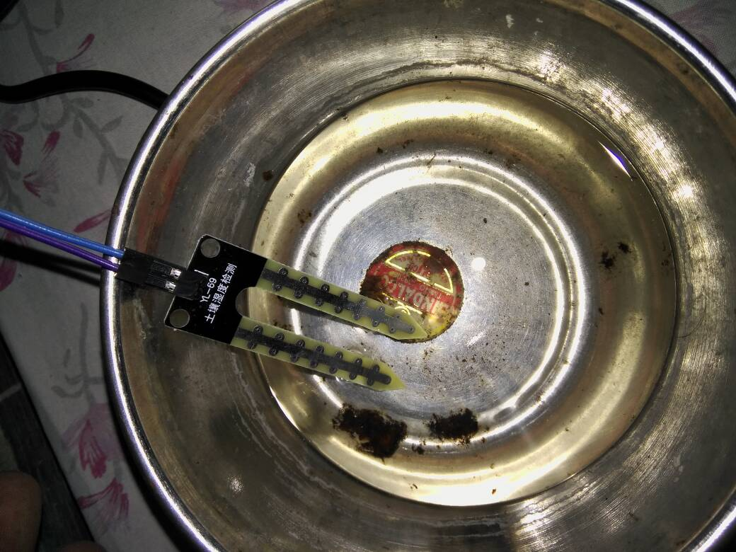
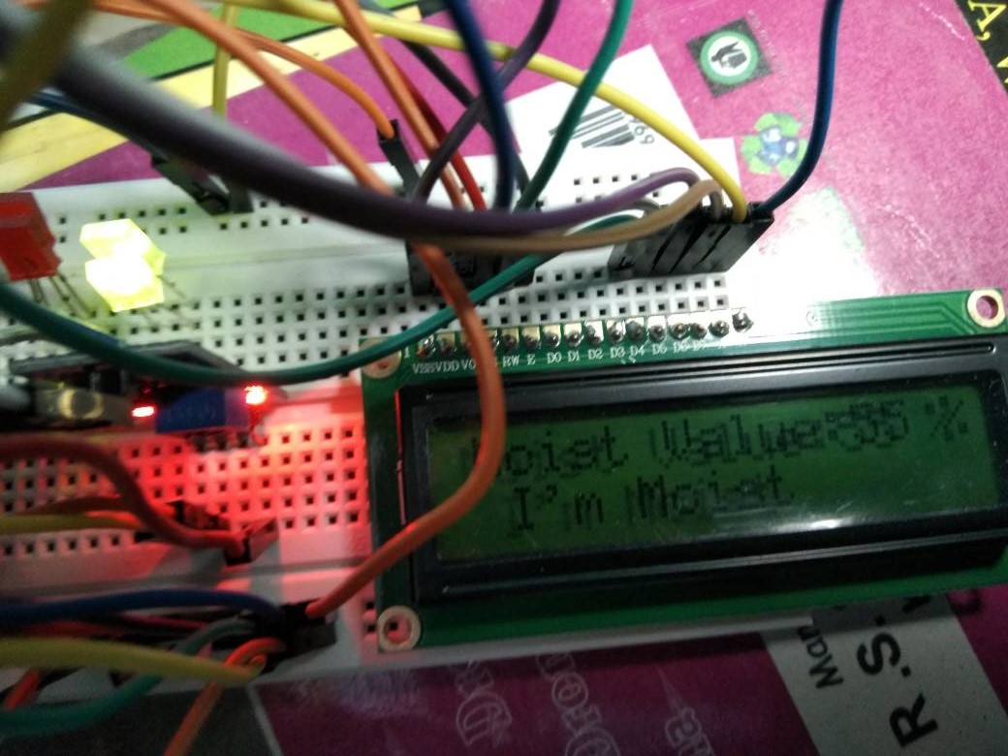
Result And Analysis(when moisturised)

Slide 11
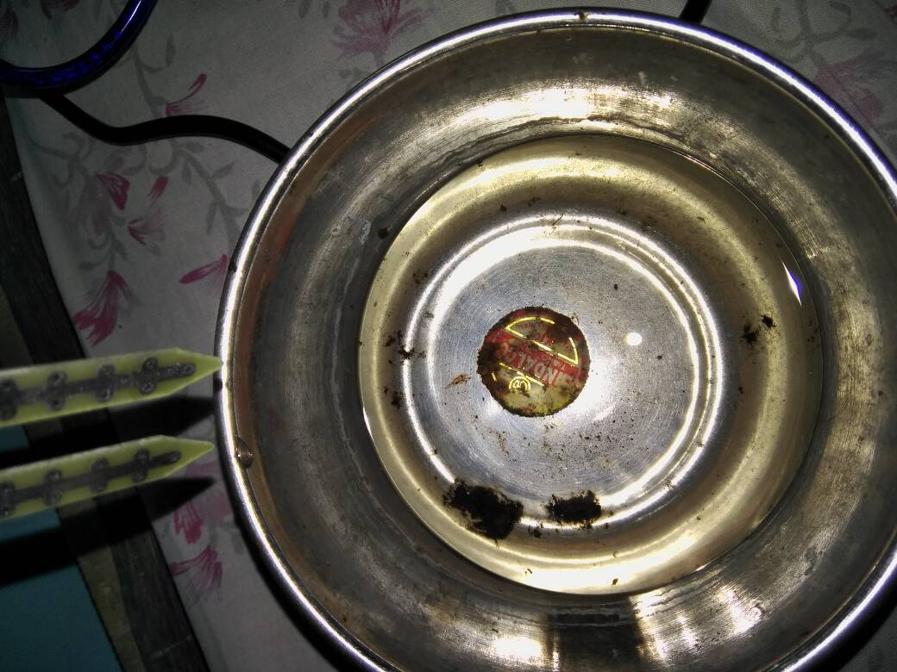
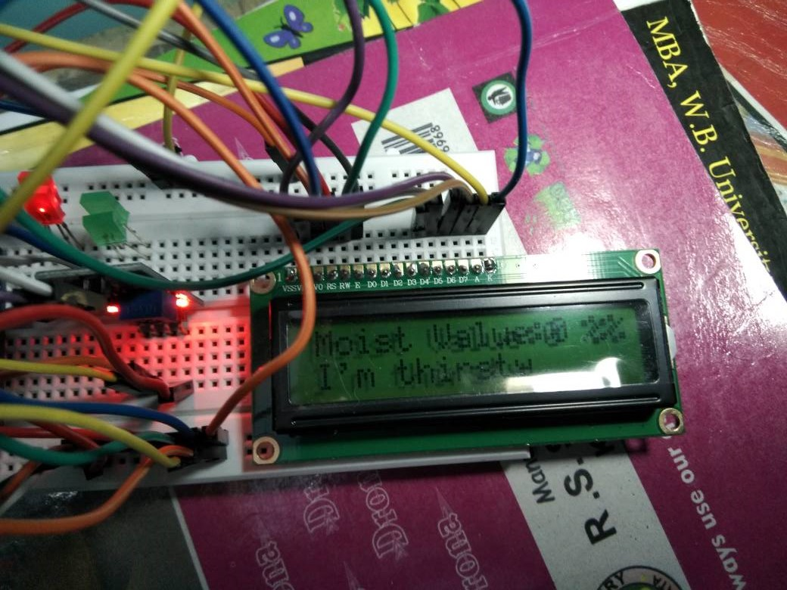
Result And Analysis(when Parched)

Slide 12
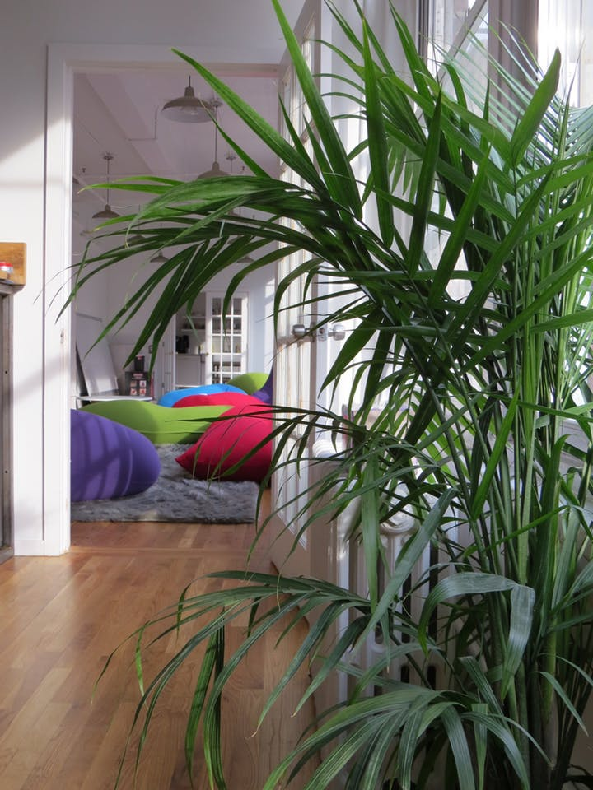
Conclusion
Before After

Slide 13
Thank You

